Slide 1
Logic Synthesis
-From RTL to Gate-Level
Song Chen
Dept. of Electronic Science and Technology
Oct. 29, 2015
http://staff.ustc.edu.cn/~songch/da-ug.htm

Slide 2
Outline
Logic Synthesis
  Logic Optimization: Technology Independent Optimization
    Two-level logic optimization
    Multi-level logic optimization
  Technology Mapping: Technology Dependent Optimization
    Mapping to Standard Cells (Standard-Cell based ASIC)
    Mapping to Look-up tables (FPGA, Optional)
Appendix – CMOS Gates

Slide 3
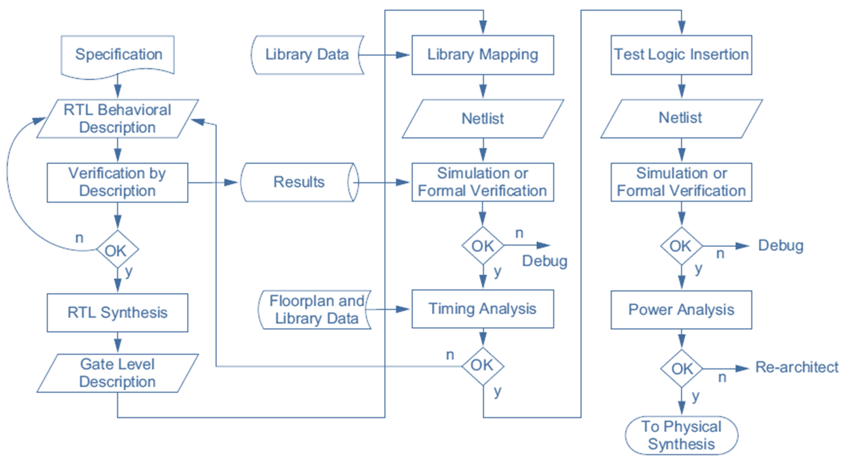

Logic Synthesis Flow

Slide 4
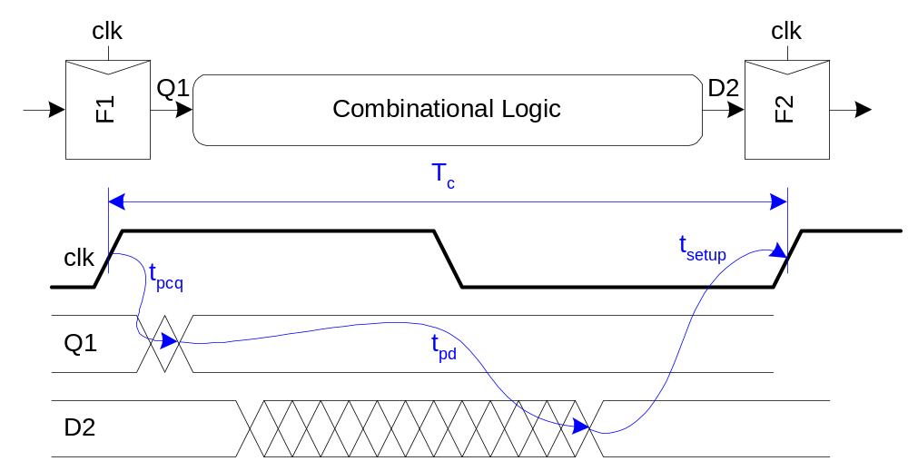
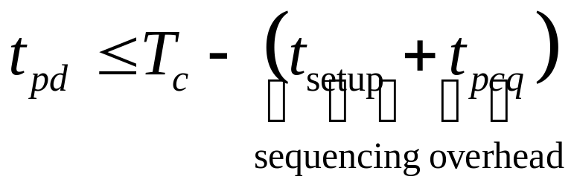
Max-Delay: Flip-Flops

Slide 5
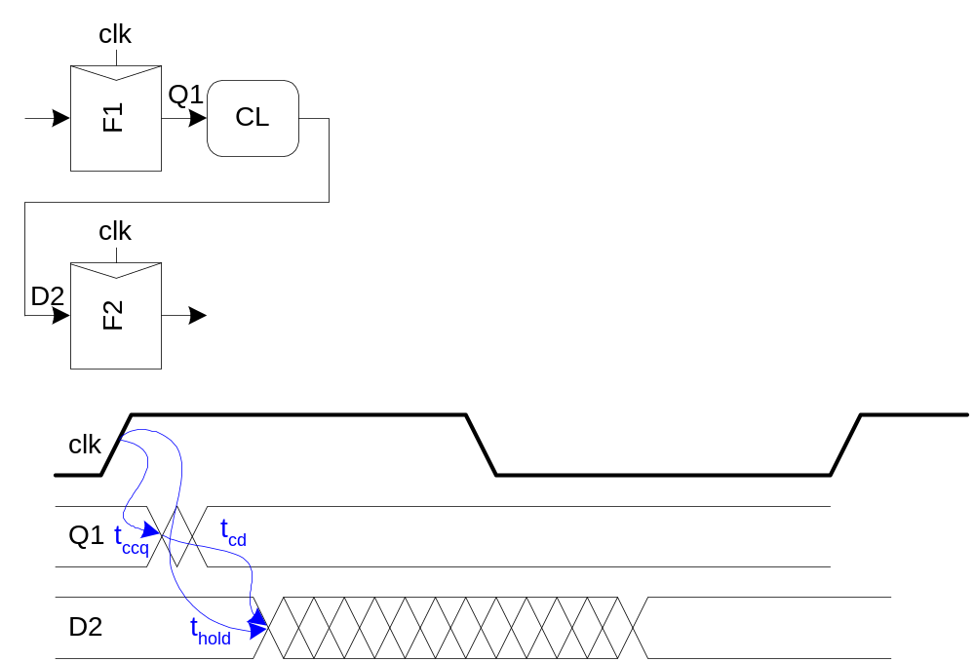
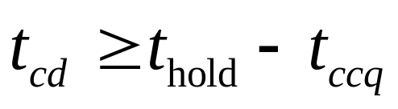
Min-Delay: Flip-Flops

Slide 6
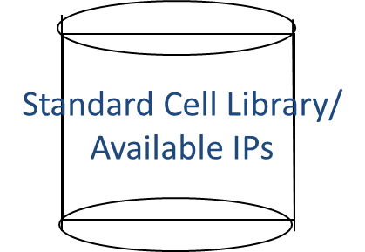
Logic Synthesis Flow from RTL to gates
RTL Description
Technology Independent Optimization
Translation
Un-optimized
Intermediate
Representation
Logic Optimization
Factorizing, Minimizing
Commonality Extraction
Optimized
Intermediate
Representation
Technology Mapping
Design
Constraints
Optimized
Gate-level
Representation

Slide 7
Why logic optimization?
Most important metrics for a chip design:
Area:
  Size affects manufacturing and packaging costs
Performance (frequency):
  Does chip meet market/user performance goals?
Power:
  Peak power affects packaging cost (current supply, heat removal)
  Energy usage affects battery life
Area reduction, power reduction, and delay reduction improves design

Slide 8
Two-Level Logic Optimization
Two-level optimization
  Sum of Product (SOP),
    First level AND, Second level OR
    Product of Sum (POS)
  Smaller/Faster Implementation:
    Reducing the number of product terms in an equation
    reducing the size of each product term
  Find an SOP representation for a Boolean function to minimize (NP-Hard)
    Number of product terms
    Number of literals, or
    Combination of both.

Slide 9
Two-level Boolean Minimization
Two Steps
  Generate the set of prime product-terms for the function
  Select a minimum set of prime terms to cover the function
Quine-McCluskey Method

Slide 10
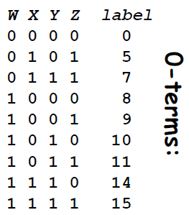
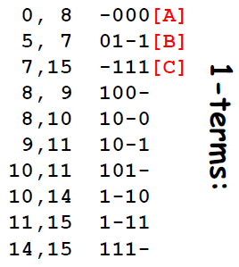
Prime Term Generation
Express your Boolean function
  Using 0-terms (product terms with no don’t care entries).
Include only those entries where the output of the function is 1
  Label each entry with it’s decimal equivalent
Look for pairs of 0-terms that
  Differ in only one bit position and
  Merge them in a 1-term (i.e., a term that has exactly one ‘–’ entry).

Slide 11


Prime Term Generation
Next:
  Examine 1-terms in pairs
  Merge into 2-terms, …
  Mark k-terms that get merged into (k+1) terms so we can discard them later
Label unmerged terms: these terms are prime!

Slide 12
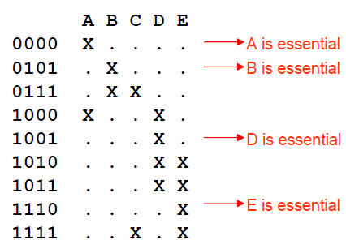
Prime Term Table
An “X” in the prime term table in row r and column c signifies that the 0-term corresponding to row r is contained by the prime corresponding to column c.
Goal: select the minimum set of primes (columns) such that there is at least one “X” in every row. This is the classical minimum covering problem.
Each row with a single X signifies an essential prime term since any prime implementation will have to include that prime term because the corresponding 0-term is not contained in any other prime.
In this example the essential primes “cover” all the 0-terms

Slide 13
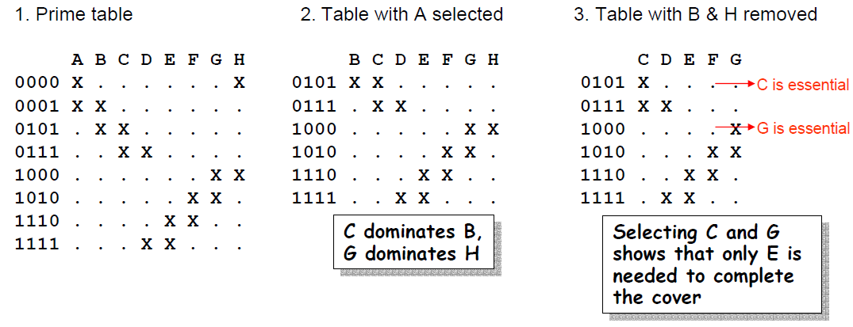
Dominated Columns
Some functions may not have essential primes (Fig. 1),
So make arbitrary selection of first prime in cover, say A (Fig. 2).
A column U of a prime term table dominates V if U contains every row contained in V. Delete the dominated columns (Fig. 3).
This gives a prime cover of {A, C, E, G}. Now backtrack to our choice of A and explore a different (arbitrary) first choice; repeat, remembering minimum cover found during search.

Slide 14
The Quine-McCluskey Method
  The input to the procedure is the prime term table T
  1. Delete the dominated primes (columns) in T. Detect essential primes in T by checking to see if any 0-term is contained by a single prime. Add these essential primes to the selected set. Repeat until no new essential primes are detected.
  2. If the size of the selected set of primes equals or exceeds the best solution thus far return from this level of recursion. If there are no elements left to be contained, declare the selected set as the best solution recorded thus far.
  3. Heuristically select a prime.
  4. Add the chosen prime to the selected set and create a new table by deleting the prime and all 0terms that are contained by this prime in the original table. Set T to this new table and go to Step 1.
  Then, create a new table by deleting the chosen prime from the original table without adding it to the selected set. No 0-terms are deleted from the original table. Set T to new table and go to Step 1.

Slide 15
The Quine-McCluskey Method
The good news
  This technique generalizes to multi-output functions (relations).
The bad news
  The search time grows as 2^(2^N) where N is the number of inputs.
  So most modern minimization systems use heuristics to make dramatic reductions in the processing time.

Slide 16
Multi-level Logic Optimization
Two-level logic is limited
  Not all Boolean functions can be efficiently represented in the SOP form
Multilevel logic implementation of a function
  Faster and smaller than two-level logic
    Preferred means of implementing combinational logic in VLSI systems
  Reuse sub-circuits,
    there are more degrees of freedom in implementing a Boolean function than in the two-level case.
  However, Largely expands the search space in identifying an optimal solution.

Slide 17
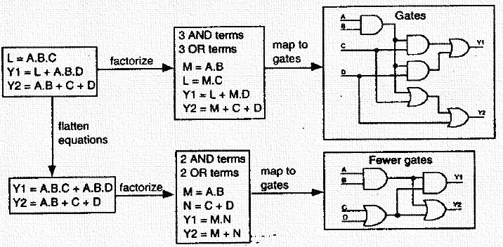
Multilevel logic optimization
Multiple level (equation) and multiple output

Slide 18
Multilevel Optimization
Flattening
  The conversion of multiple Boolean equations into a two-level sum-of-products form is called flattening. All intermediate terms are removed.
Factoring
  The factorization of Boolean functions is the process of adding intermediate terms.
    This adds implied logic structure which reduce both the size of the implied circuit and large fan-outs.
  Adding structure adds levels of logic which tends to make a smaller, but slower operating circuits.
Note: For more details, please refer to the reference book [2]. Chapter 6.3

Slide 19
Logic Synthesis Flow from RTL to gates
RTL Description
Technology Independent Optimization
Translation
Un-optimized
Intermediate
Representation
Logic Optimization
Factorizing, Minimizing
Commonality Extraction
Optimized
Intermediate
Representation
Technology Mapping
Design
Constraints
Optimized
Gate-level
Representation

Slide 20
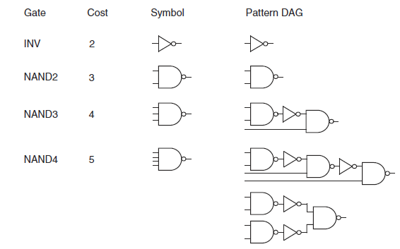
Sample Library

Slide 21
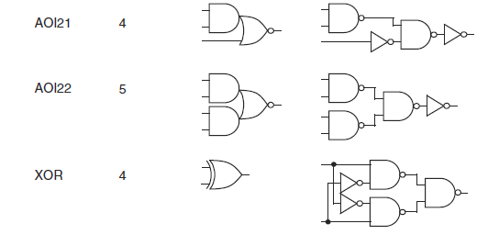
Sample Library (Cont’)

Slide 22
Optimization Example: Mapping via Directed Acyclic Graph (DAG) Covering
  Represent logic network (netlist) in canonical form => subject DAG
  Represent each library gate with canonical forms for the logic function => pattern DAGs
  Each pattern DAG has a cost
  Goal:
    Find a minimum cost covering of the subject DAG by the pattern DAGs

Slide 23

Trivial Covering
Reduce netlist into NAND2 gates → subject DAG
7 NAND2 = 21
5 INV = 10
31 (area cost)

Slide 24
Covering #1
2 INV = 4
2 NAND2 = 6
1 NAND3 = 4
1 NAND4 = 5
19 (area cost)

Slide 25
Covering #2
1 INV = 2
1 NAND2 = 3
2 NAND3 = 8
1 AOI21 = 4
17 (area cost)

Slide 26
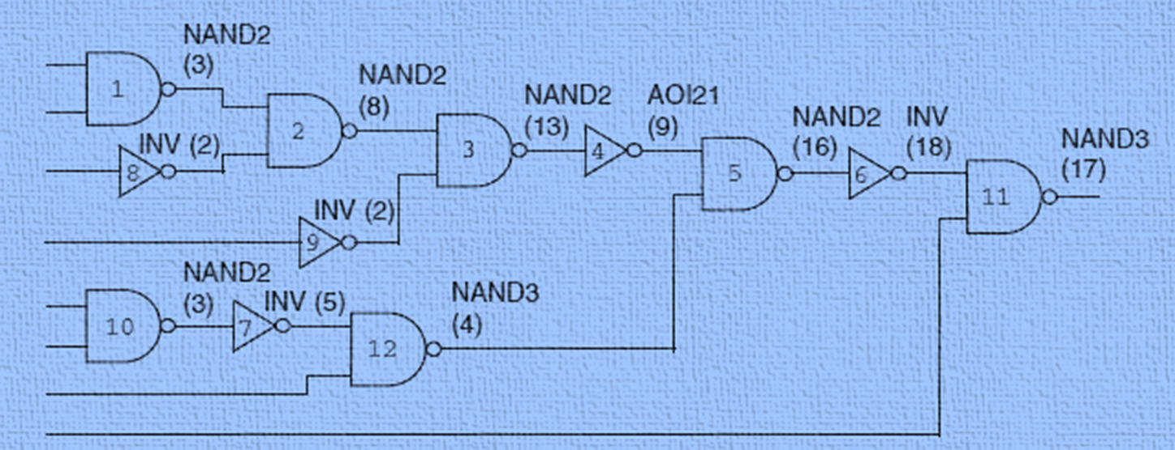
Dynamic Programming for
Optimum Tree Covering

Slide 27
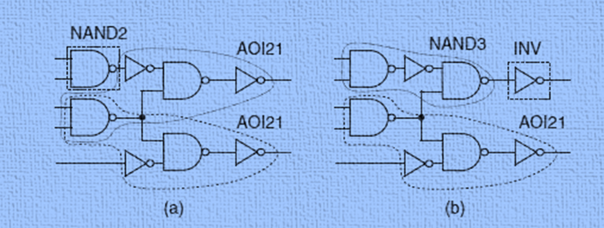
Examples of Cover: Non-Tree Case
(a). Legal (b). Illegal

Slide 28
Multiple fan-out
NP-hard
Heuristic: partitioning the DAG into a forest

Slide 29
Partitioning a Graph
1. Break at multiple fanout points
2. Partition input netlist into a forest of trees
3. Solve each tree optimally
4. Stitch trees back together

Slide 30
Optimum Tree Covering
INV
11 + 2 = 13
AOI21
4 + 3 = 7
NAND2
2 + 6 + 3 = 11
NAND2
3 + 3 = 6
INV
2
NAND2
3
NAND2
3
Dynamic Programming: Try all the possibilities at each gate, topological Order
Pls. refer to Reference [2] Chapter 6.4 for more details.

Slide 31
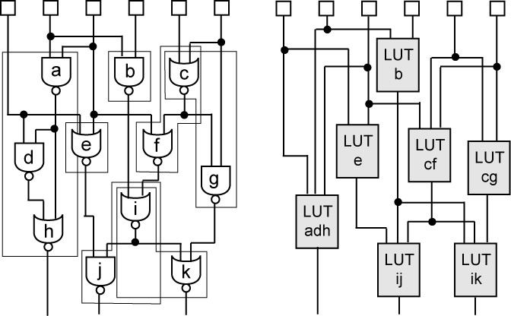
Mapping to Look-up Tables
Perform clustering on the following 2-bounded network
  Intra-cluster and node delay = 0, inter-cluster = 1
  Pin constraint = 3
Max delay = 2

Slide 32
Reference
Logic Optimization
  Reference 2, Chapter 6.3, 6.4

Slide 33
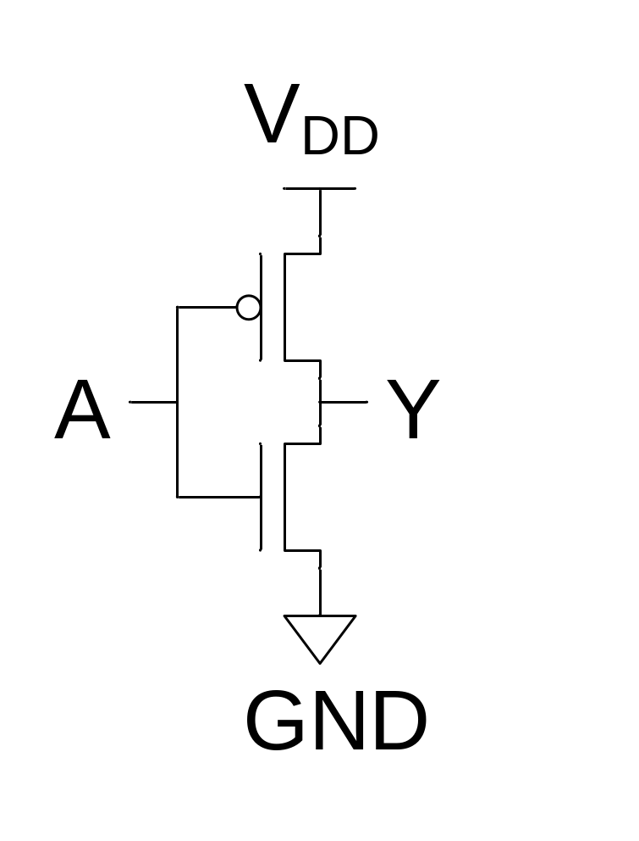
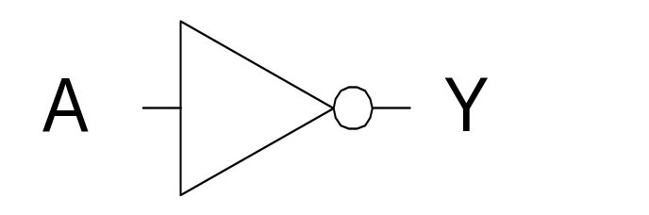
CMOS Inverter （反向器）
A | Y
0 | 1
1 | 0
ON
OFF
1
0
ON
OFF

Slide 34
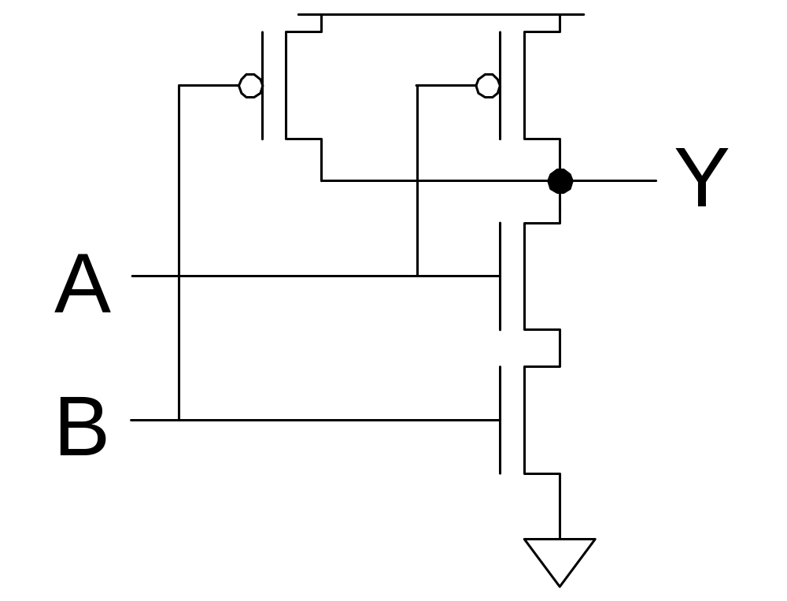
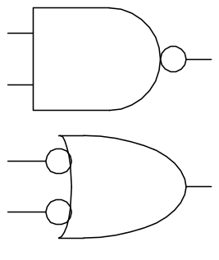
CMOS NAND Gate
A | B | Y
0 | 0 | 1
0 | 1 | 1
1 | 0 | 1
1 | 1 | 0
OFF
ON
OFF
ON
ON
ON
OFF
OFF
0
0
1
1
OFF
ON
OFF
ON
0
1
0
1
OFF
OFF
ON
ON

Slide 35
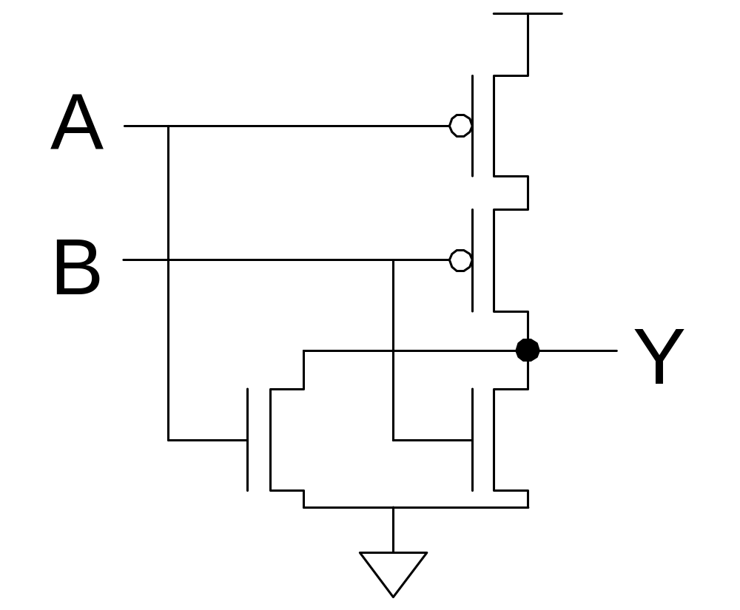
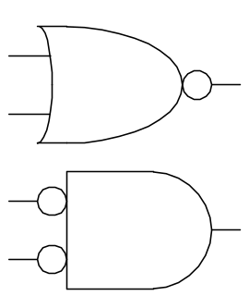
CMOS NOR Gate
A | B | Y
0 | 0 | 1
0 | 1 | 0
1 | 0 | 0
1 | 1 | 0

Slide 36
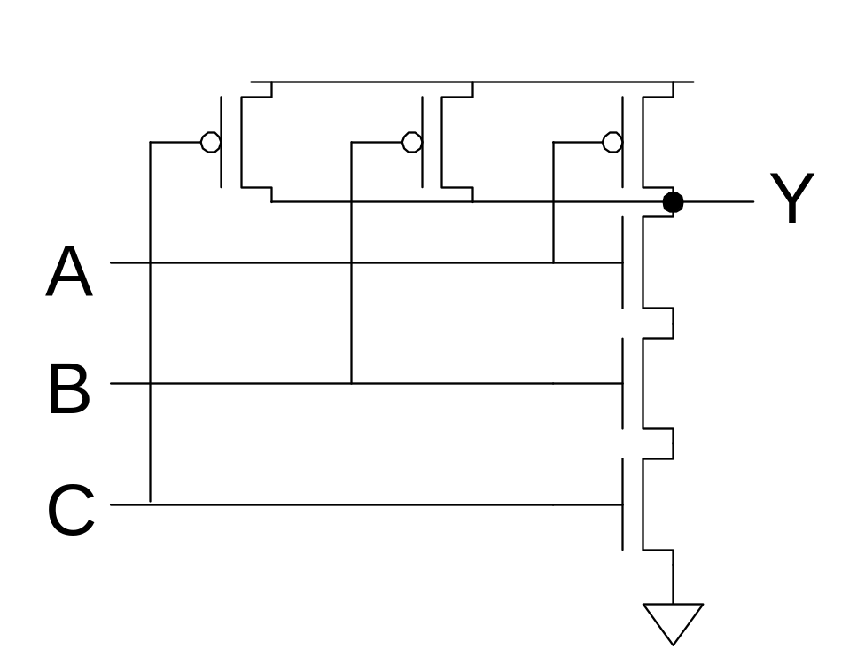
3-input NAND Gate
Y pulls low if ALL inputs are 1
Y pulls high if ANY input is 0

Slide 37
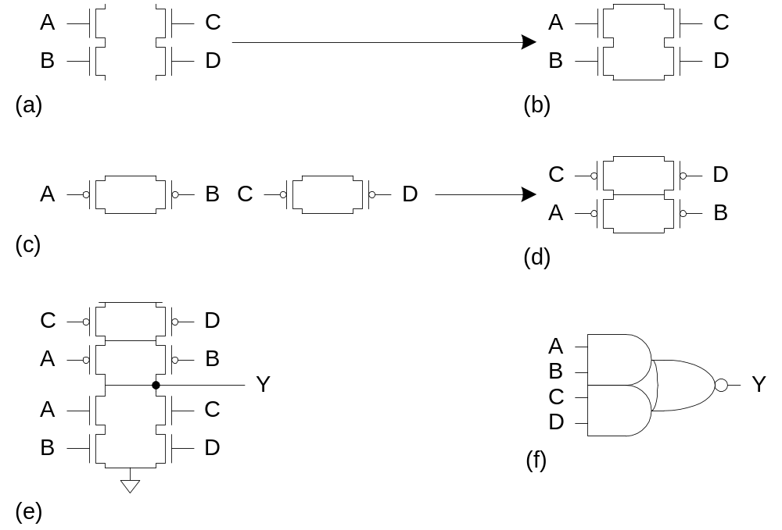
Compound Gates
Compound gates can do any inverting function
Ex:

Slide 38
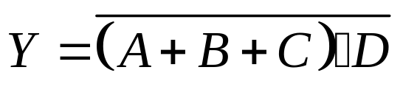
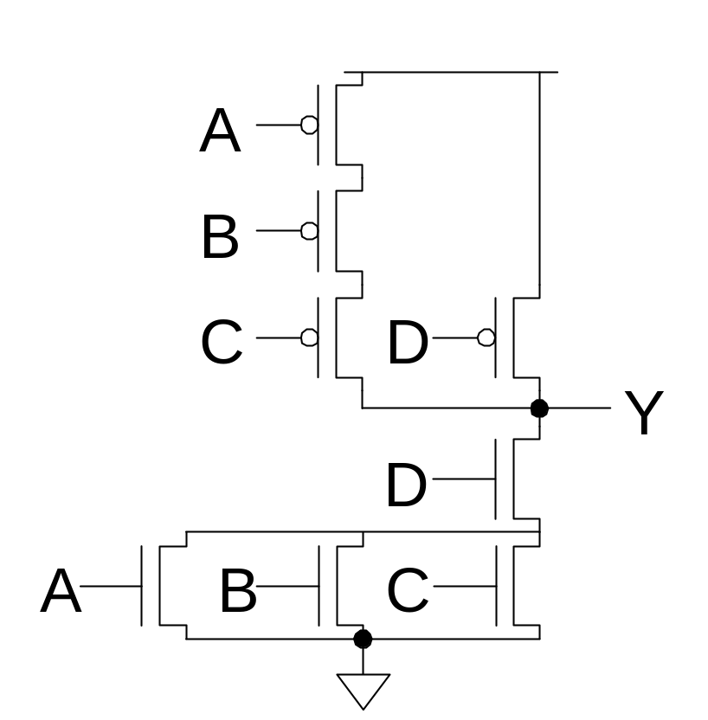
Example: O3AI

Slide 39
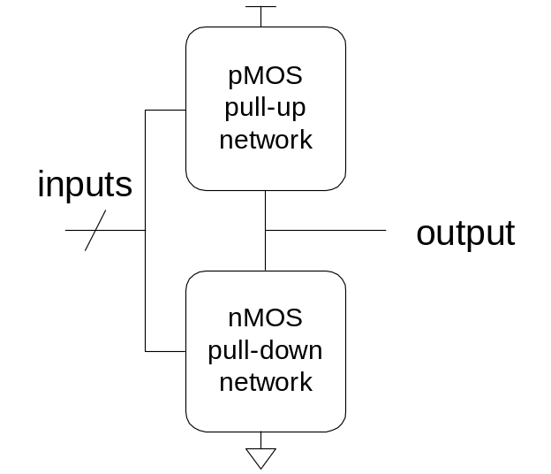
Complementary CMOS
Complementary CMOS logic gates (cells)
  nMOS pull-down network
  pMOS pull-up network
  a.k.a. static CMOS
 | Pull-up OFF | Pull-up ON
Pull-down OFF | Z (float) | 1
Pull-down ON | 0 | X (crowbar)

Slide 40

Conduction Complement
Complementary CMOS gates always produce 0 or 1
Ex: NAND gate
  Series nMOS: Y=0 when both inputs are 1
  Thus Y=1 when either input is 0
  Requires parallel pMOS
Rule of Conduction Complements
  Pull-up network is complement of pull-down
  Parallel -> series, series -> parallel

